Slide 1
Introduction to
Statistical Methods
ISM Team

Slide 2
Lead Faculty: Dr. G. Krishnakumari
Faculty Name: Dr. V. Srinivasan
Email : vsrinivasan@wilp.bits-pilani.ac.in
LF: Dr. Murali Kumar Jilla
Email: muralikumarj@wilp.bits-Pilani.ac.in
Session 13
(31st January/ 1st Feb 2026)

Slide 3
Contact Session 13
Contact Session 13: Module 5 : Prediction & Forecasting
Contact Session | List of Topic Title | Reference
CS - 13 | Time Series Models – AR Model, MA Model, ARMA Model, ARIMA | T3
HW | Problems on Time Series | T3

Slide 4


Slide 5
Autocovariance
Stationarity implies that the joint distribution of pair of observations y_{t1}, y_{t2} viz.,
f(y_{t1}, y_{t2}) = f(y_{t1+h}, y_{t2+h})
for any integer h. That is, the joint distribution of any pair of observations on time points which differ by a constant quantity is the same for such pairs

Slide 6
Autocovariance
Thus
f(y_{t}, y_{t+h}) = f(y_{t1}, y_{t1+h}) = f(y_{t2}, y_{t2+h})
have the same distribution.
The form of f(y_{t}, y_{t+h}) can be inferred by plotting values of (y_{t}, y_{t+h}); t = 1, 2, …., i.e., values of y_{t} separated by lag h.

Slide 7

Autocovariance
Let {Y_{t}} be a Time Series with E {Y_{t}²} < ∞. The mean function of {Y_{t}} is µ_{y}(t) = E(Y_{t}).
The covariance function of {Y_{t}, Y_{t+h}} is
γ_{h}= Cov (Y_{t}, Y_{t+h}) = E[(Y_{t}-µ)(Y_{t+h}-µ)]
In general
γ_{y}(r, s) = Cov (Y_{r}, Y_{s}) = E[{Y_{r}-µ_{y}(r)}{Y_{s}-µ_{y}(s)}]
for all integers r and s

Slide 8
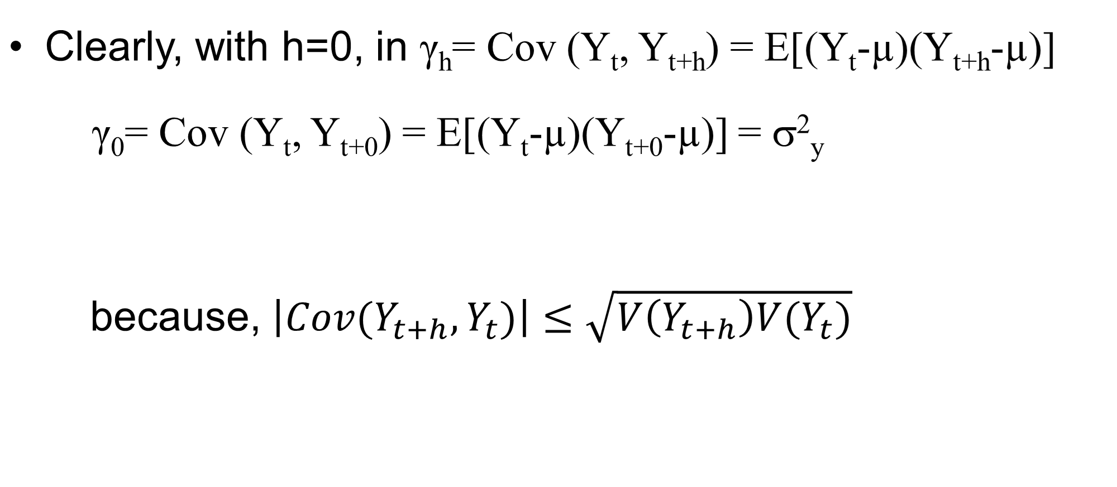




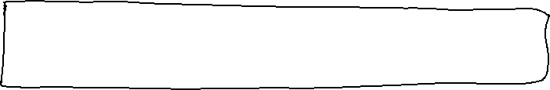
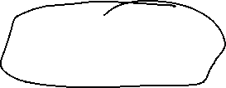




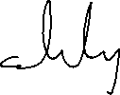









Autocovariance

Slide 9
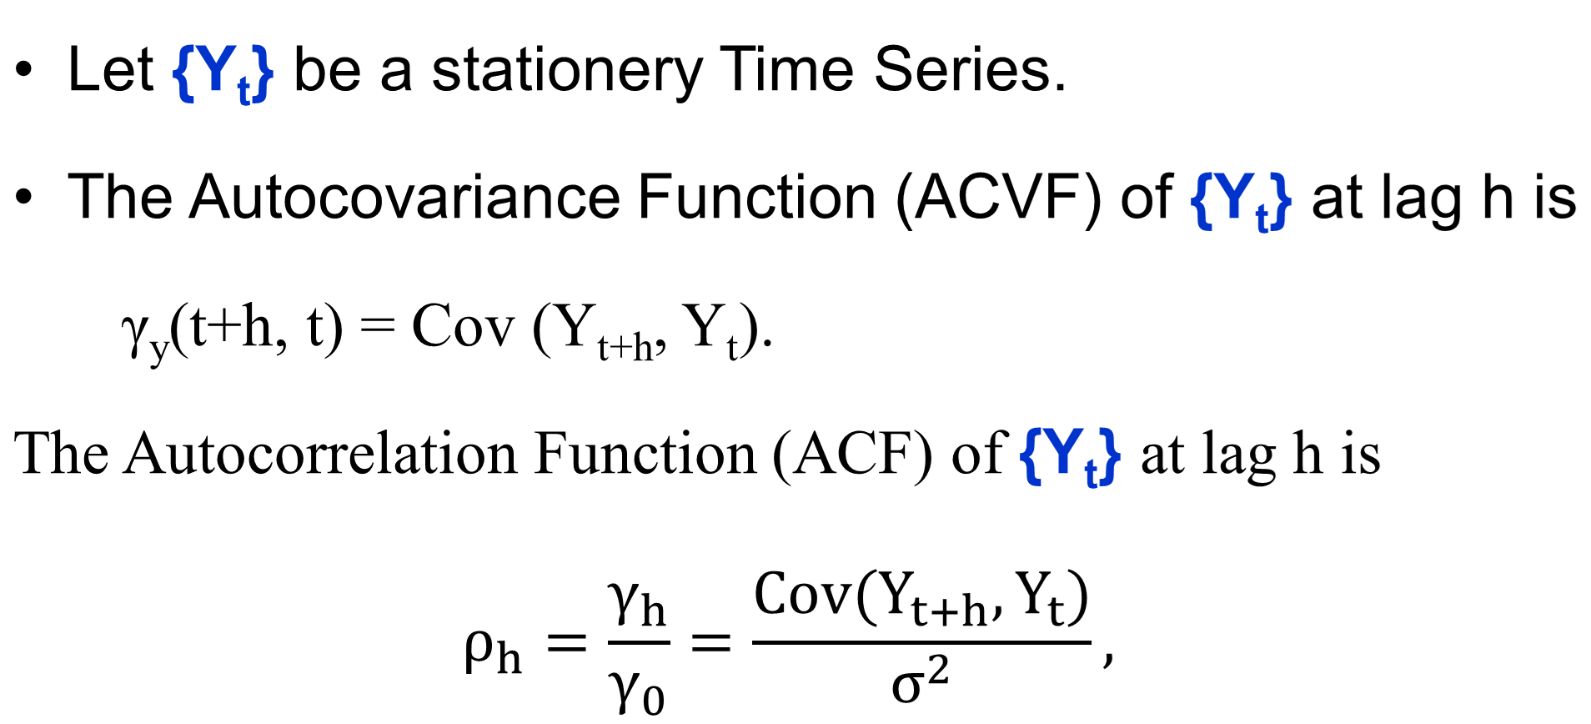












Autocovariance function

Slide 10
Time Series
Autocorrelation
The autocorrelation measures the degree of relationship of the same variable between the observation at the current time period and the observations at the prior time periods.
It measures how the lagged version of the value of a variable is related to the original version of it in time series.

Slide 11
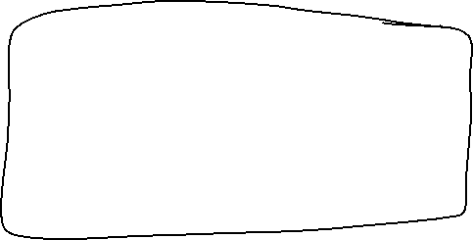
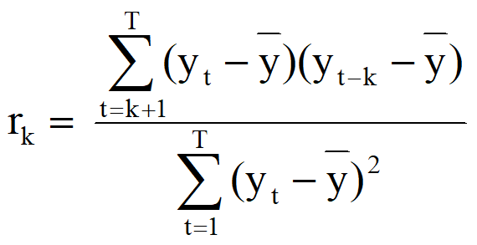
Autocorrelation
The value of r_{k} can be written as
where T is the length of time series.

Slide 12
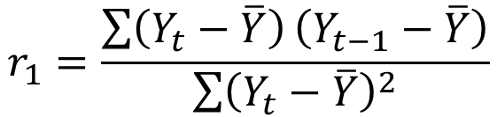
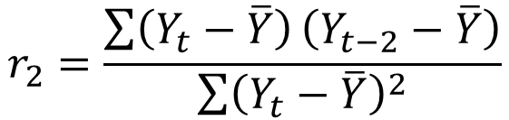
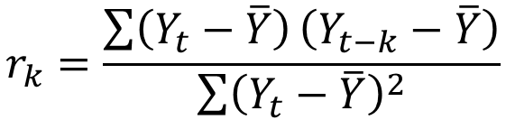
Autocorrelation
Autocorrelation between (Y_{t}, Y_{t-1})
Autocorrelation between (Y_{t}, Y_{t-2})
Autocorrelation between (Y_{t}, Y_{t-k})

Slide 13
Year | 2011 |  |  |  | 2012
Quarter | Q1 | Q2 | Q3 | Q4 | Q1 | Q2 | Q3 | Q4
Retail quarterly sale (million) (Y_{t}) | 147772 | 154400 | 166188 | 170202 | 173264 | 175371 | 184957 | 186395
Year | 2013 |  |  |  | 2014
Quarter | Q1 | Q2 | Q3 | Q4 | Q1 | Q2 | Q3 | Q4
Retail quarterly sale (million) (Y_{t}) | 191130 | 191213 | 195749 | 198262 | 199980 | 209566 | 212529 | 213754
Year | 2015 |  |  |  | 2016
Quarter | Q1 | Q2 | Q3 | Q4 | Q1 | Q2 | Q3 | Q4
Retail quarterly sale (million) (Y_{t}) | 222124 | 224372 | 229871 | 236260 | 238044 | 244076 | 244944 | 245799
Year | 2017 |  |  |  | 2018
Quarter | Q1 | Q2 | Q3 | Q4 | Q1 | Q2
Retail quarterly sale (million) (Y_{t}) | 251125 | 254557 | 255223 | 264793 | 265064 | 277282

Slide 14
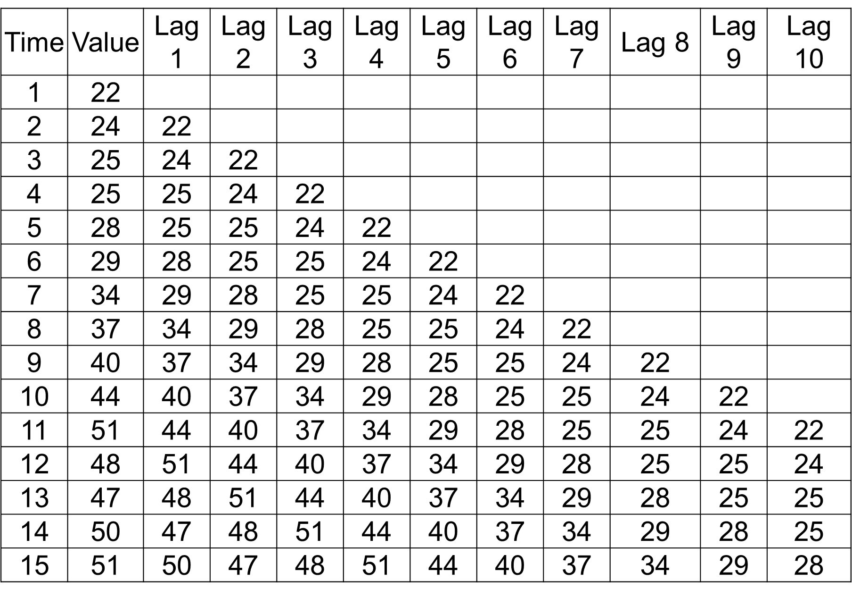

Slide 15
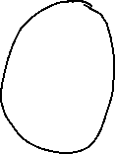
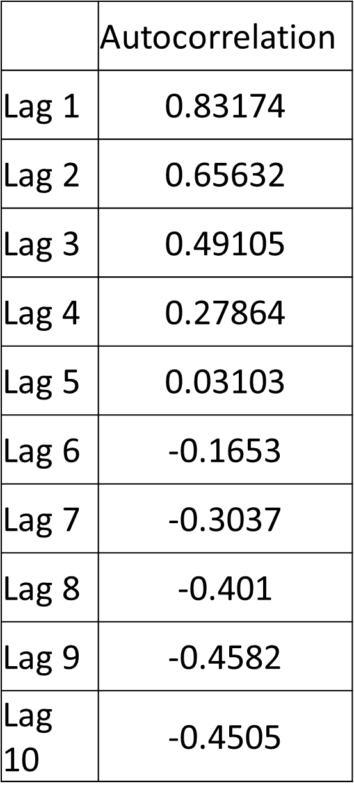
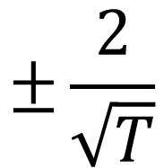
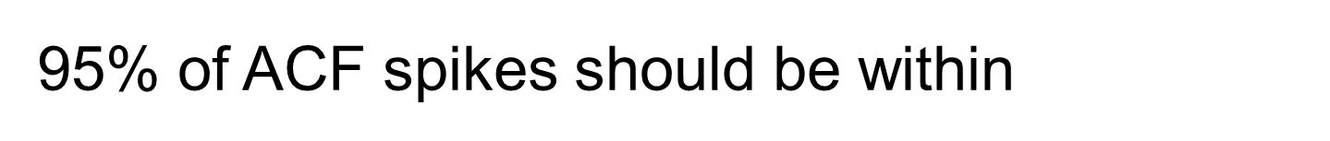

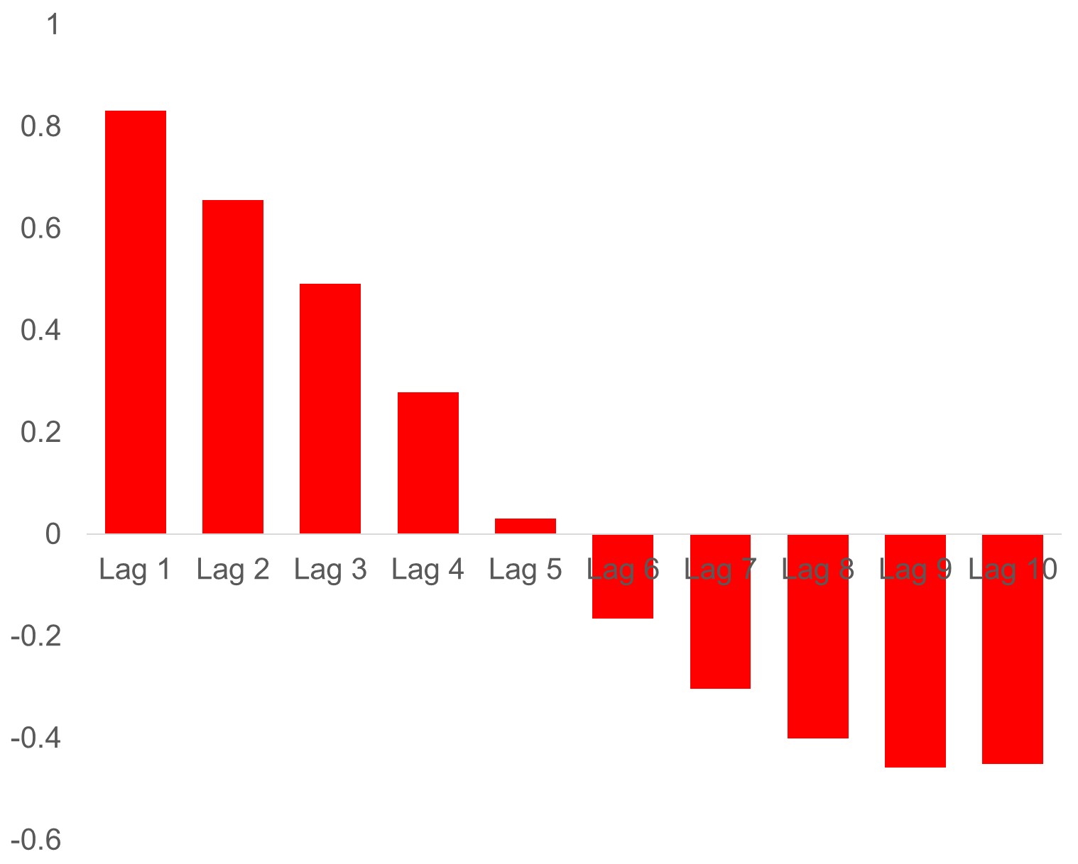







Slide 16
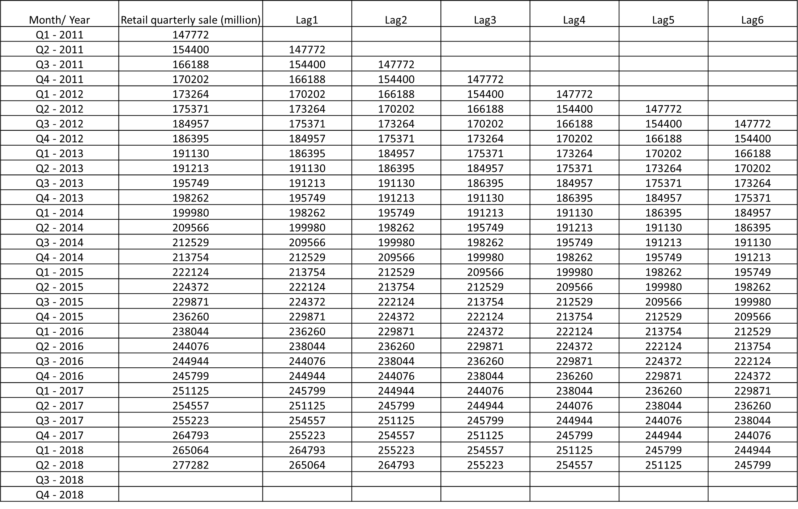

Slide 17
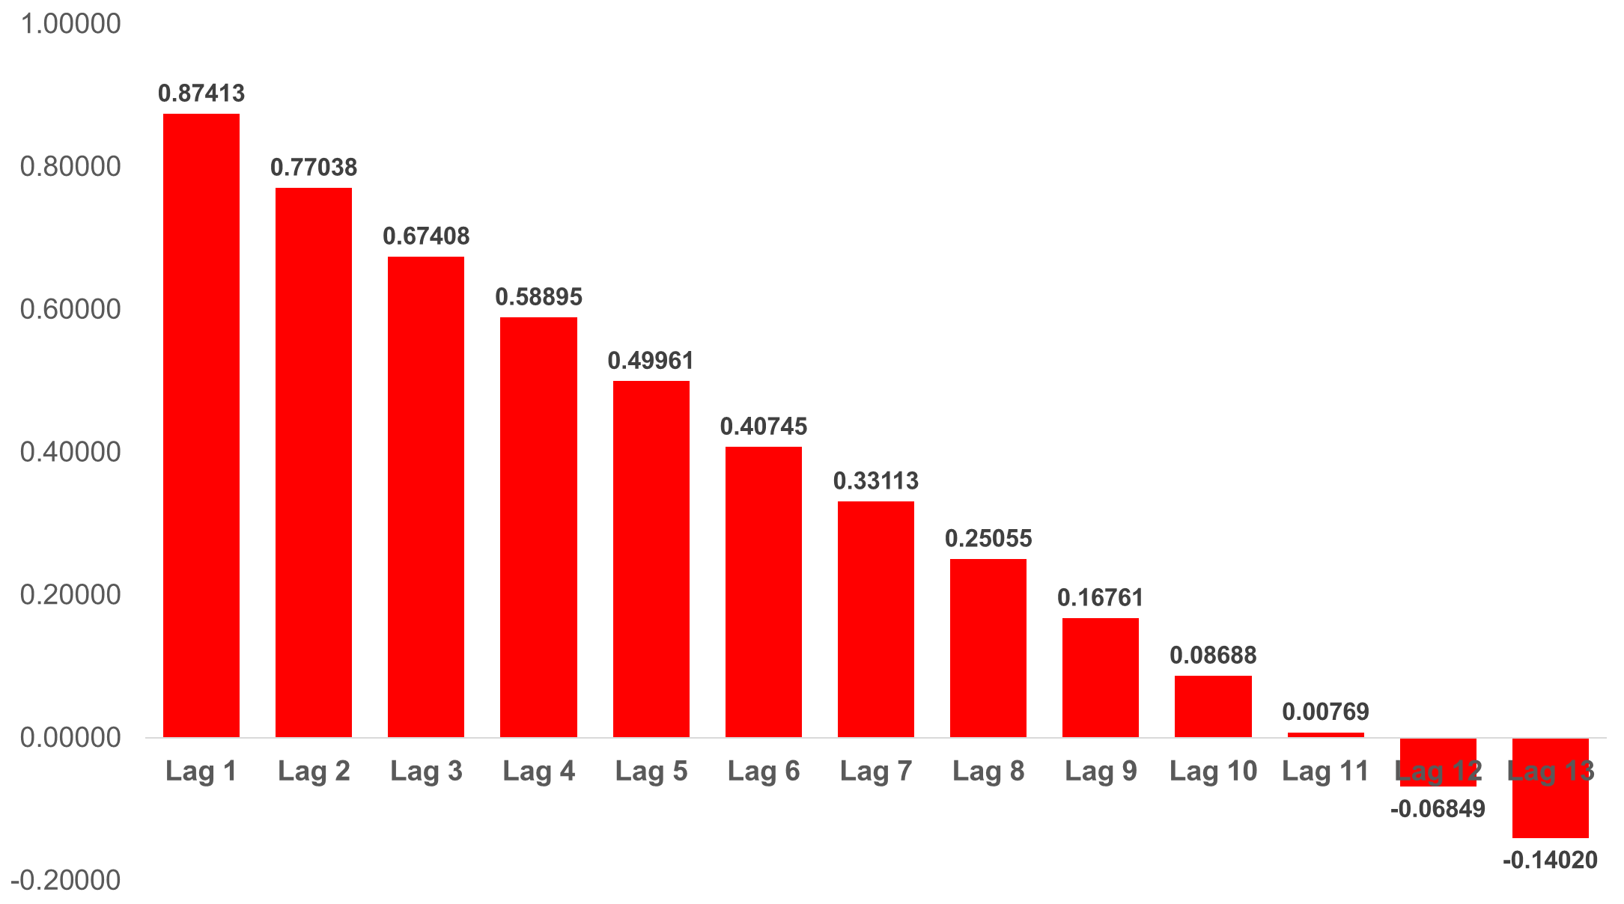

Slide 18
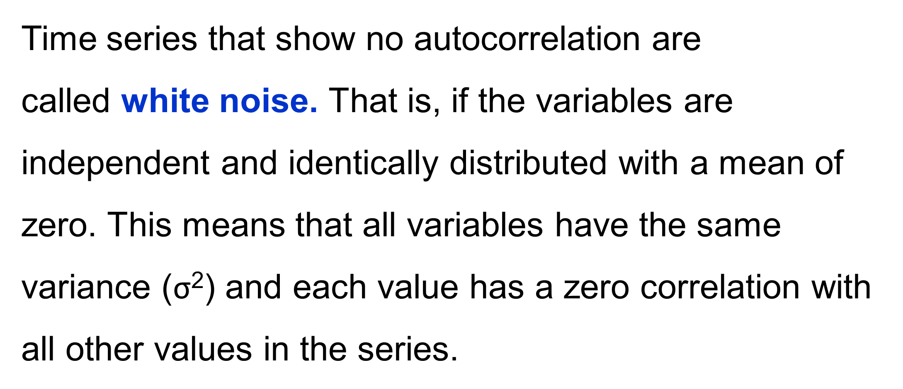
White Noise

Slide 19
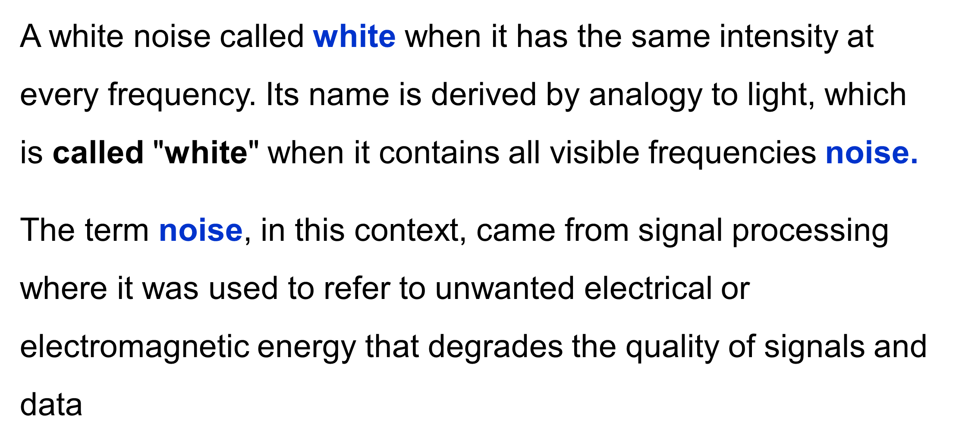
White Noise

Slide 20
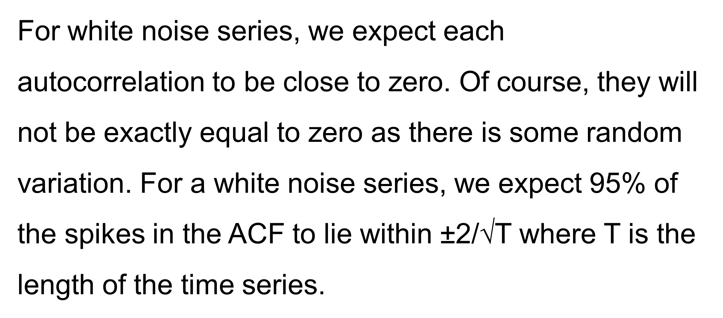
White Noise

Slide 21
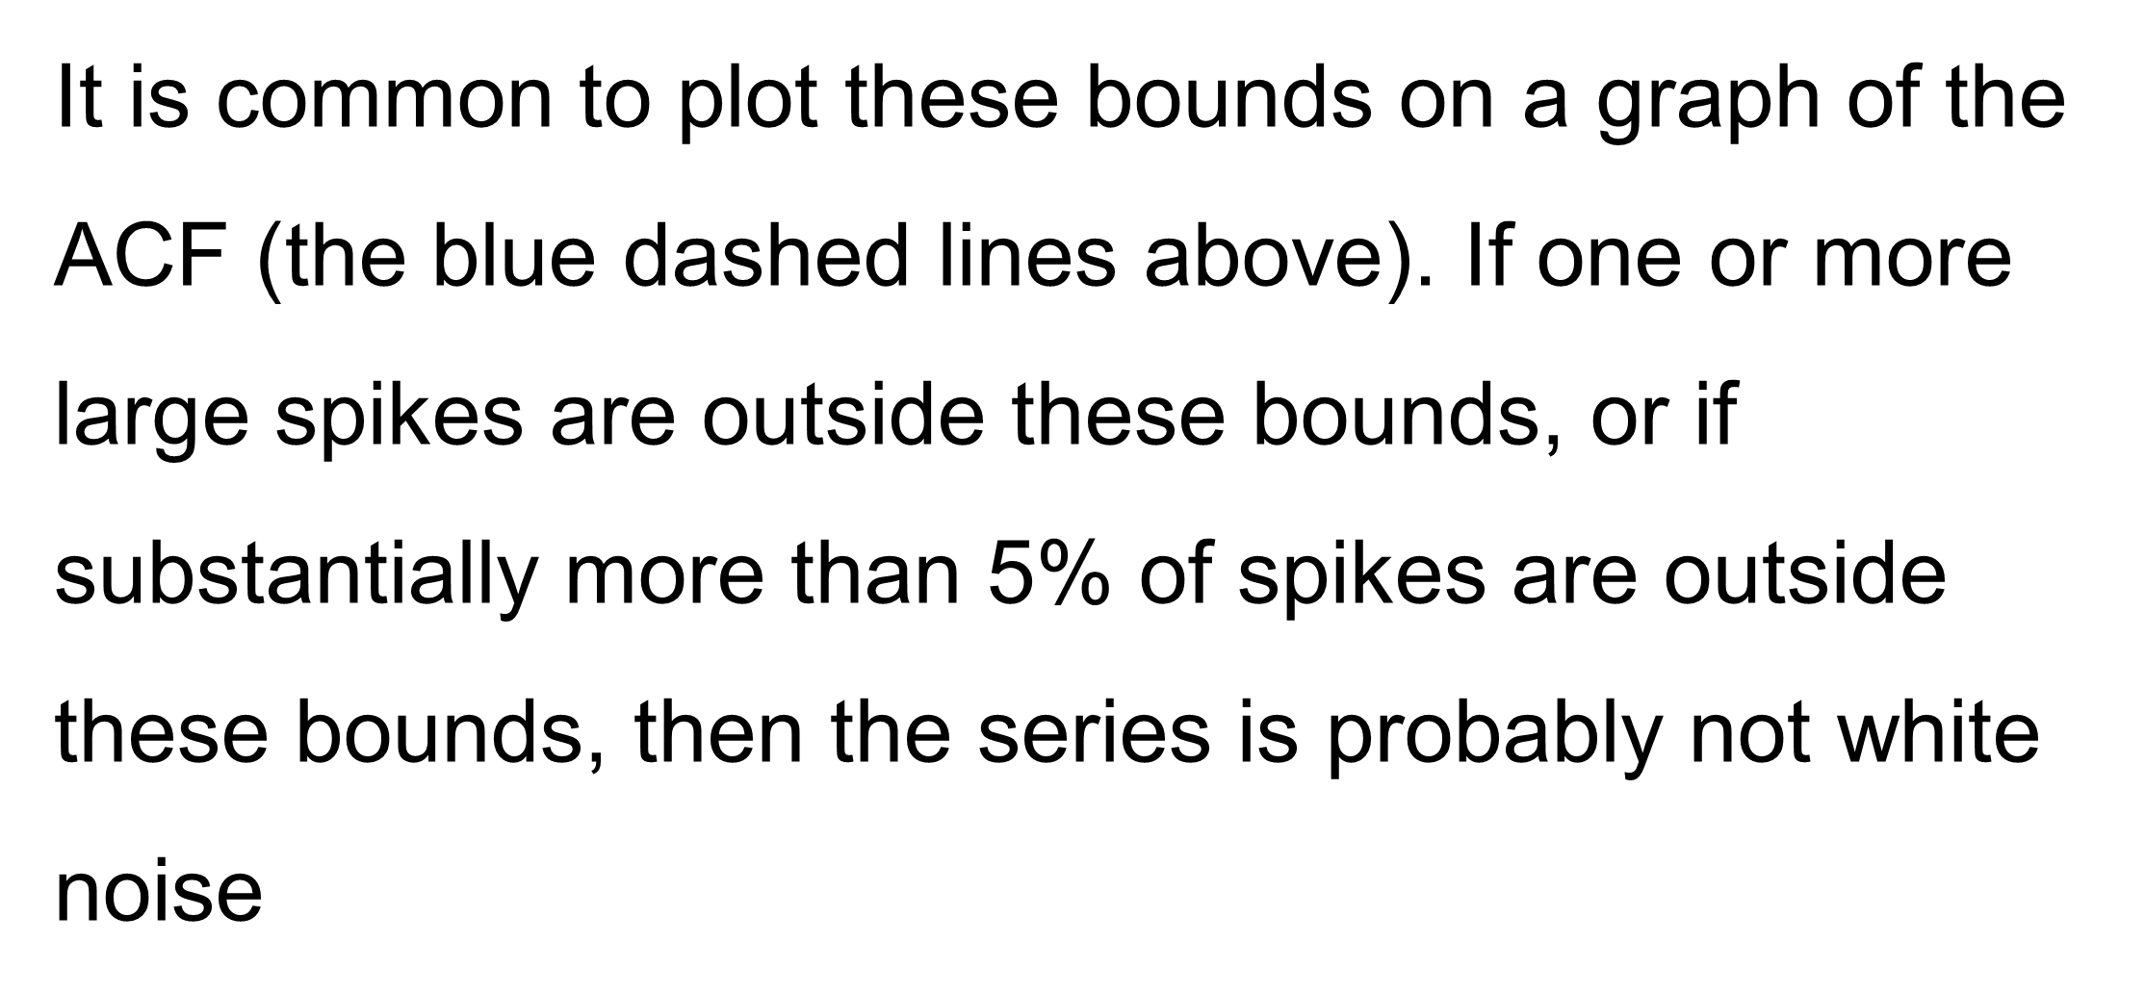
White Noise

Slide 22
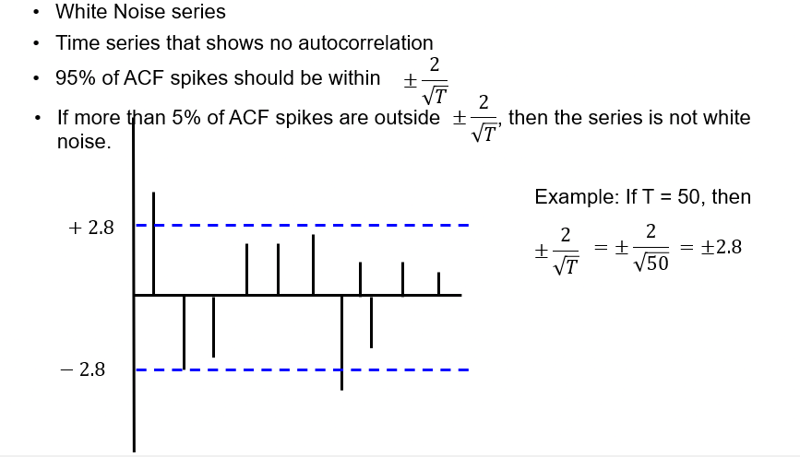
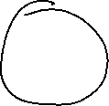








Slide 23
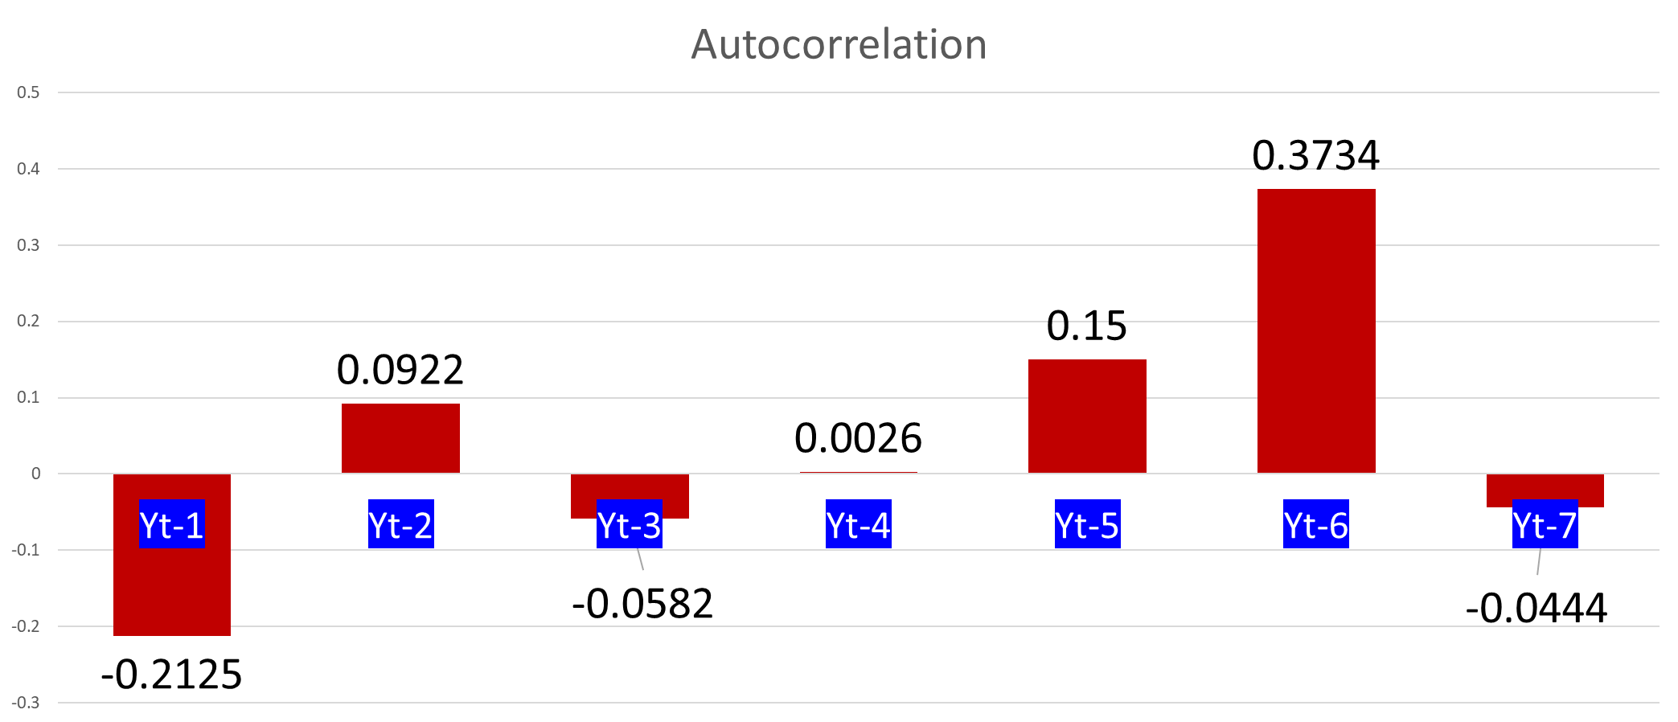

Slide 24
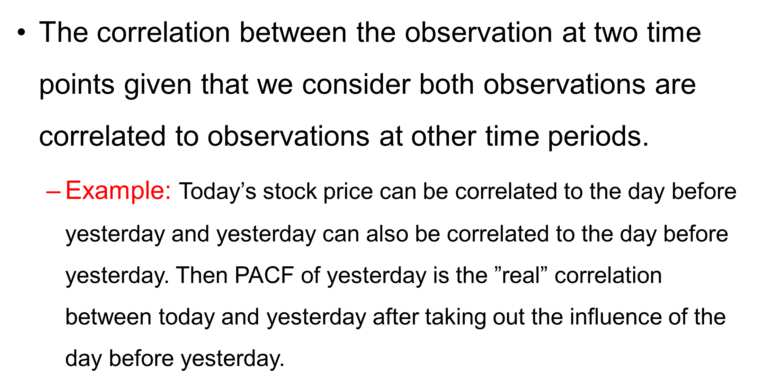
Partial Autocorrelation Function (PACF)

Slide 25

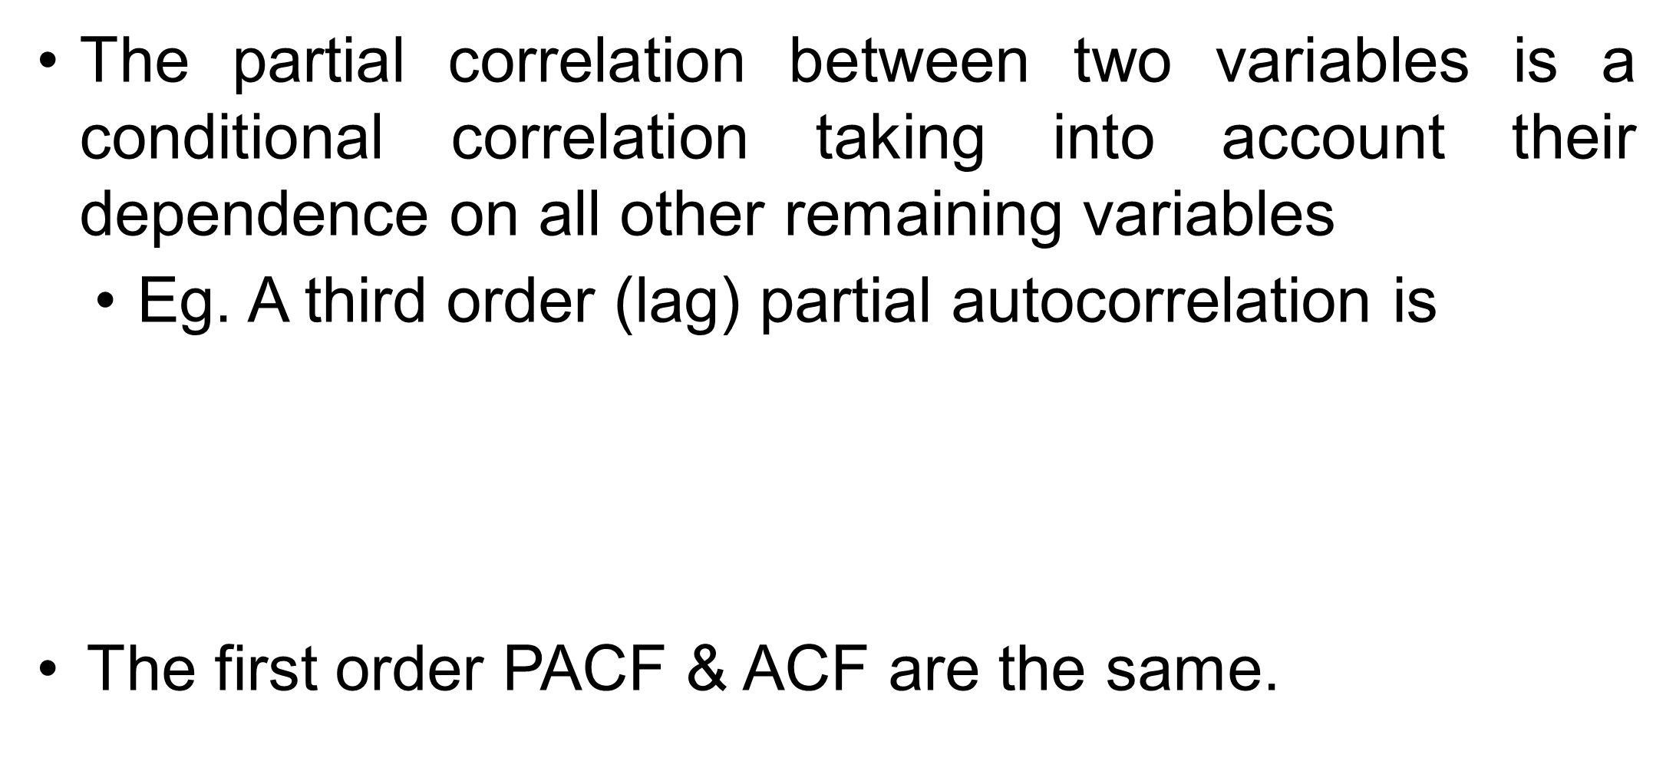
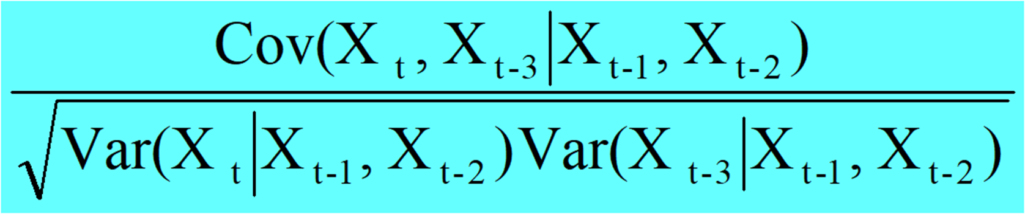






Slide 26
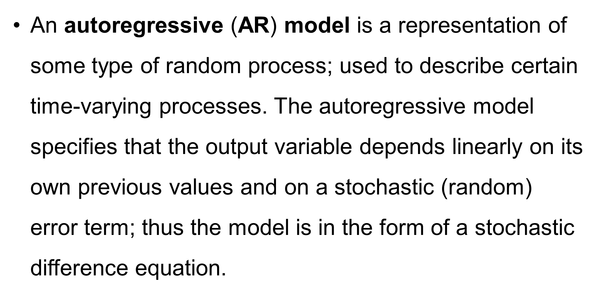
Autoregressive (AR) models

Slide 27
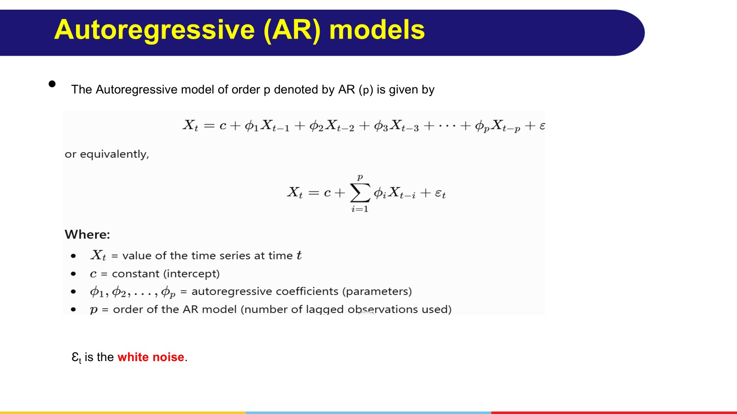

Slide 28
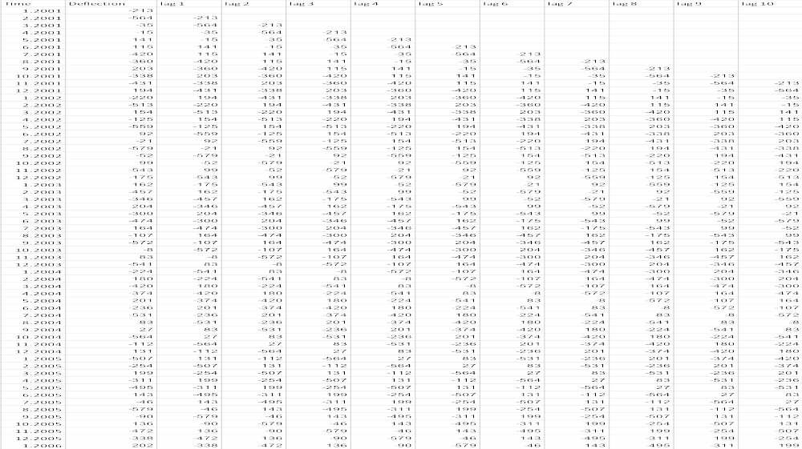

Slide 29
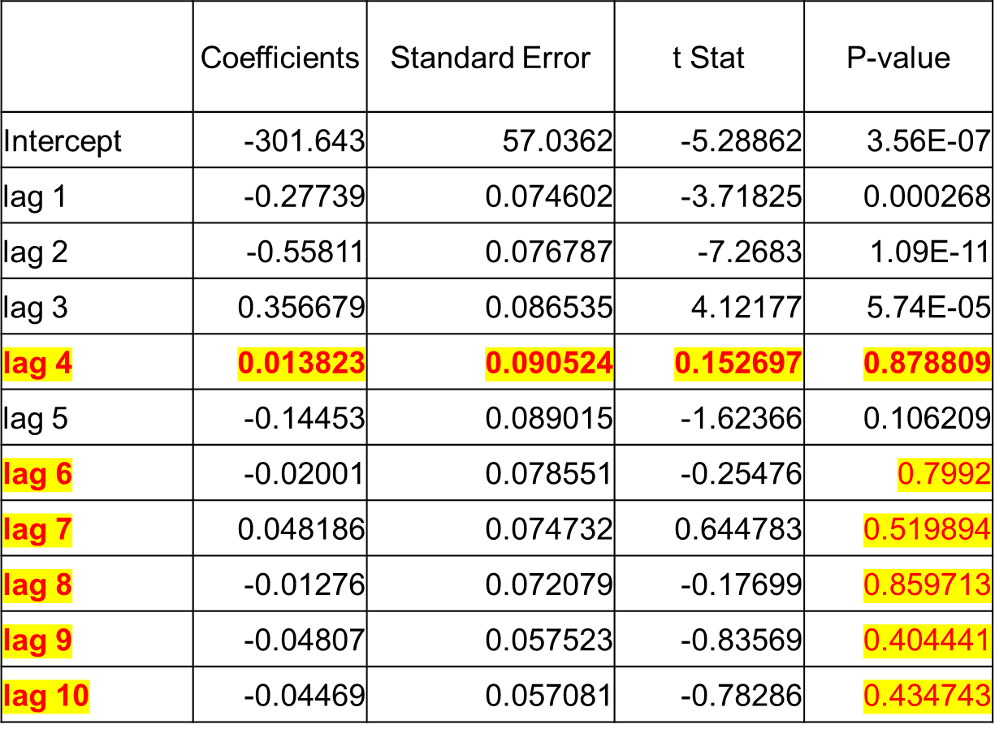
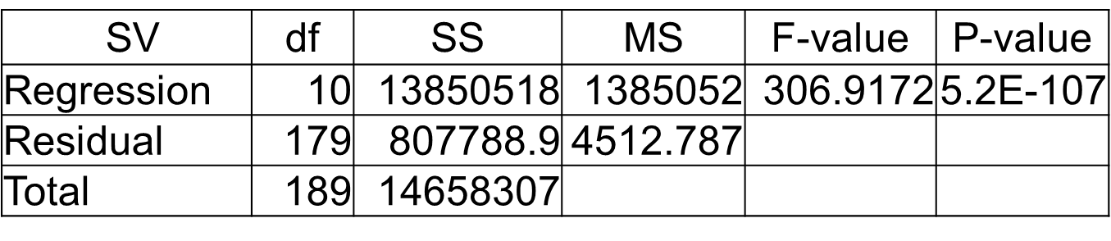
Regression Statistics | Results
Multiple R | 0.972056
R Square | 0.944892
Adjusted R Square | 0.941813
Standard Error | 67.17728
Observations | 190

Slide 30
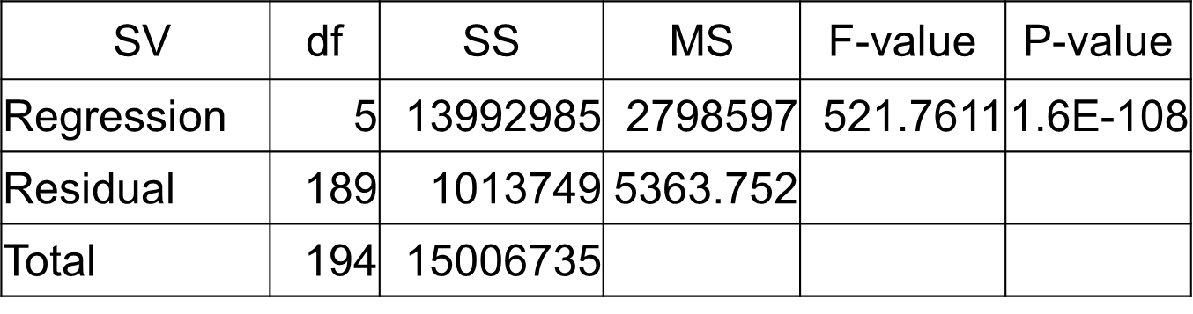
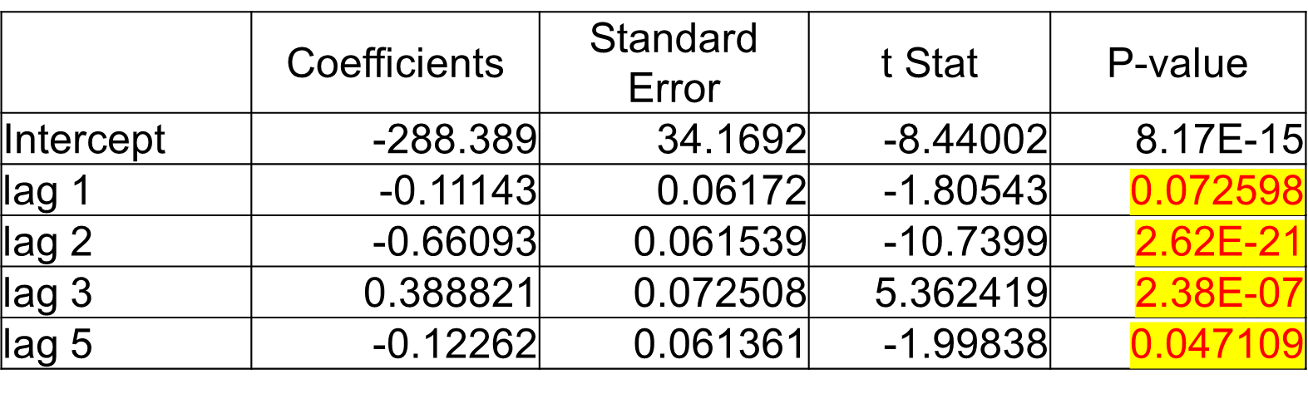
Regression Statistics | Results
Multiple R | 0.965633
R Square | 0.932447
Adjusted R Square | 0.93066
Standard Error | 73.23764
Observations | 195
ANOVA
Y_{t} = b₀+b₁X_{t-1}+b₂X_{t-2}+b₃X_{t-3}+b₅X_{t-5}
Y_{t} = -288.389 - 0.11143 *X_{t-1} - 0.66093*X_{t-2} + 0.388821*X_{t-3} - 0.12262*X_{t-5}

Slide 31
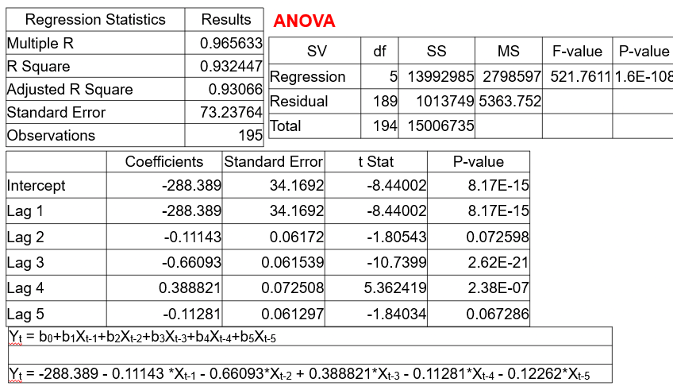

Slide 32
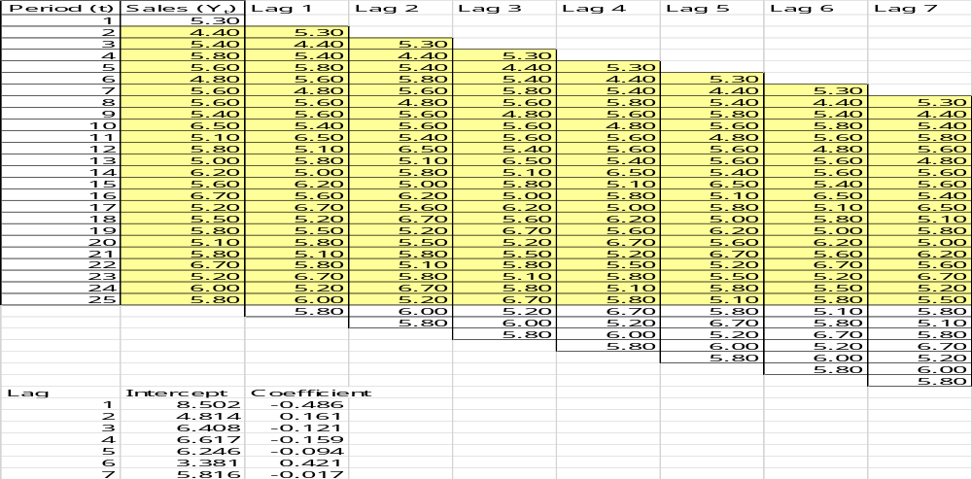

Slide 33
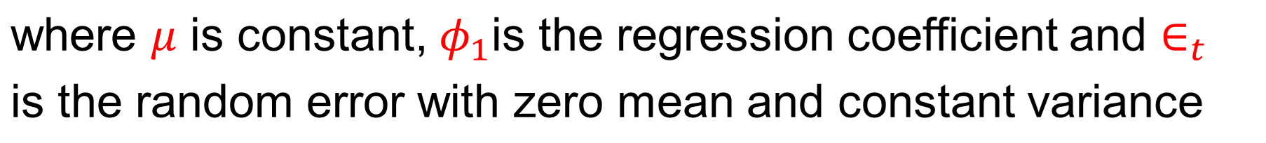
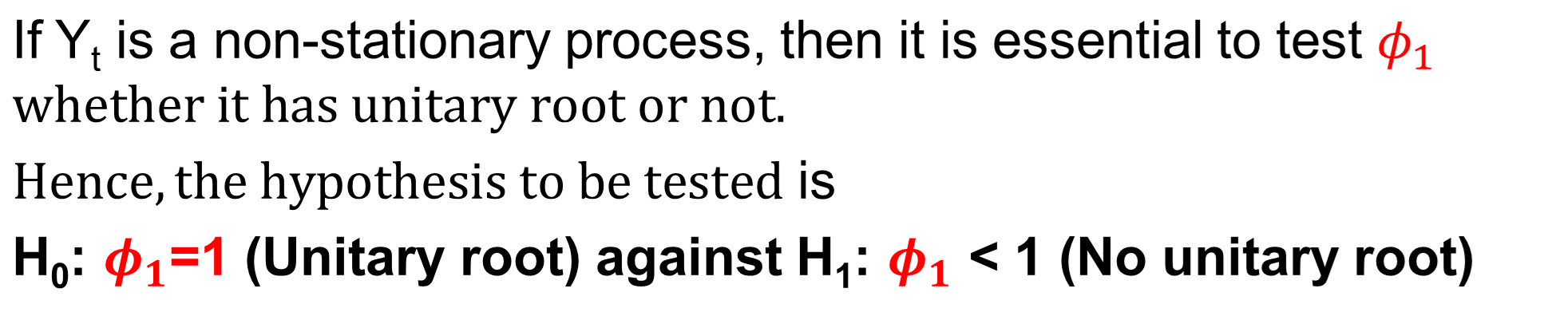






Test for stationarity using Dickey-Fuller test
Consider the first order autoregressive model

Slide 34

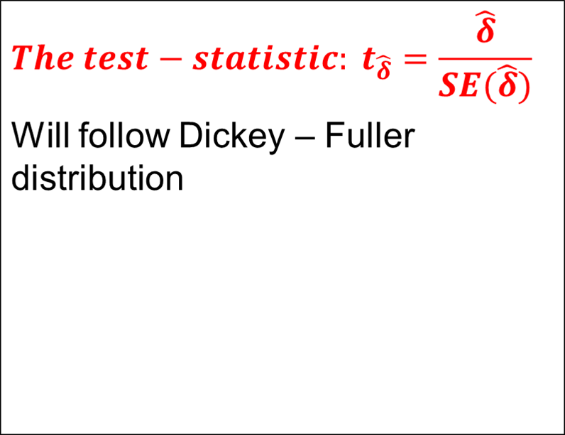
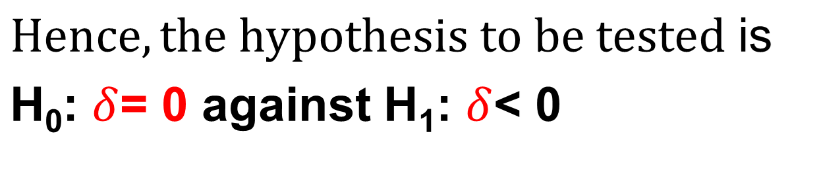
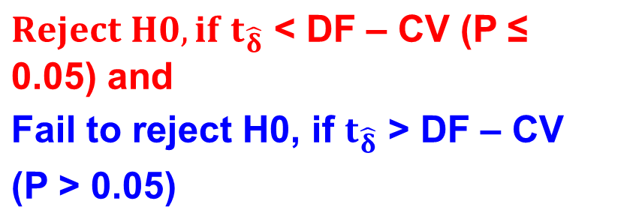


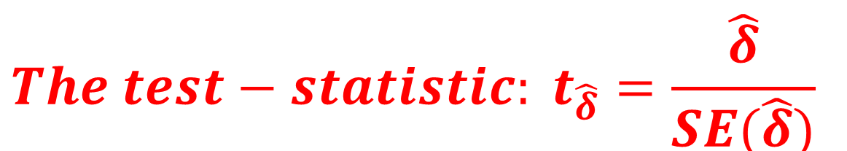


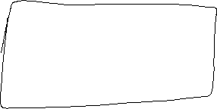





Test for stationarity using Dickey-Fuller test
By rewriting the model (1)

Slide 35
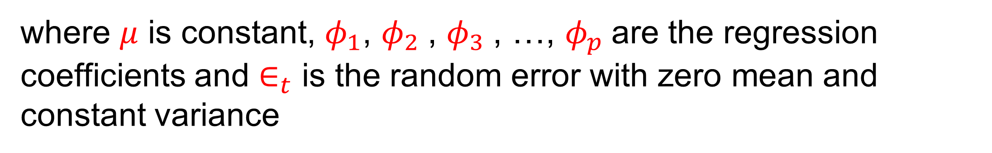
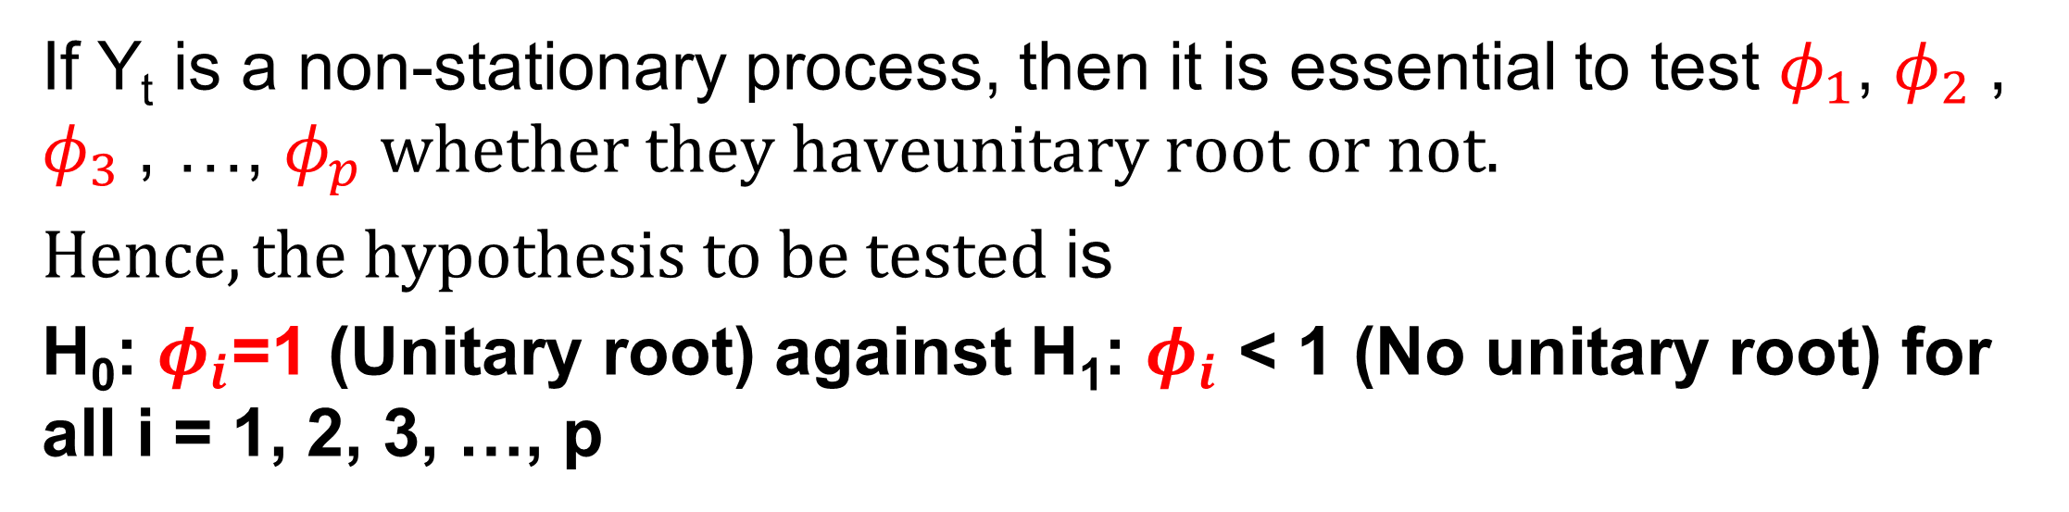
Test for stationarity using Dickey-Fuller test

Slide 36
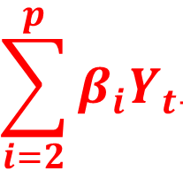
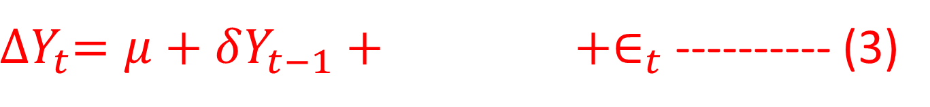
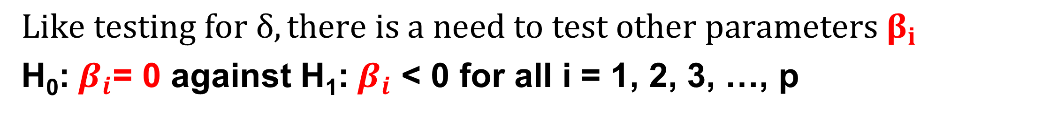
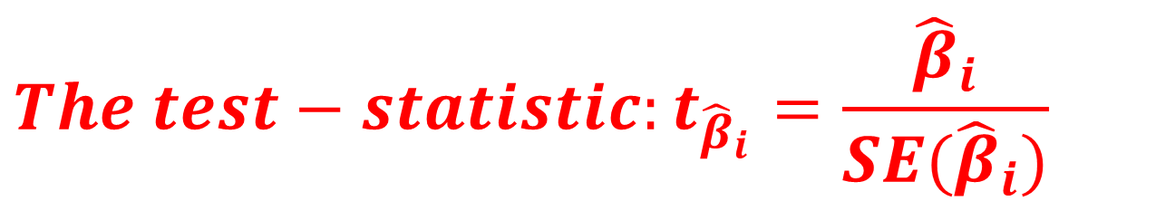



Test for stationarity using Dickey-Fuller test

Slide 37


Slide 38



Slide 39

Autoregressive Moving Average (ARMA) Model

Slide 40

Autoregressive Moving Average (ARMA) Model
The AR and MA models dynamics can be combined into what is called an autoregressive moving-average (ARMA) model.
The ARMA (1, 1) is

Slide 41




Slide 42


Slide 43



Slide 44



Autoregressive Integrated Moving Average (ARIMA) Model
I Integrated: The use of differencing of raw observations in order to make the time series stationary

Slide 45


Slide 46

Autoregressive Integrated Moving Average (ARIMA) Model

Slide 47

Autoregressive Integrated Moving Average (ARIMA) Model

Slide 48


Slide 49


